Slide 1


Slide 2
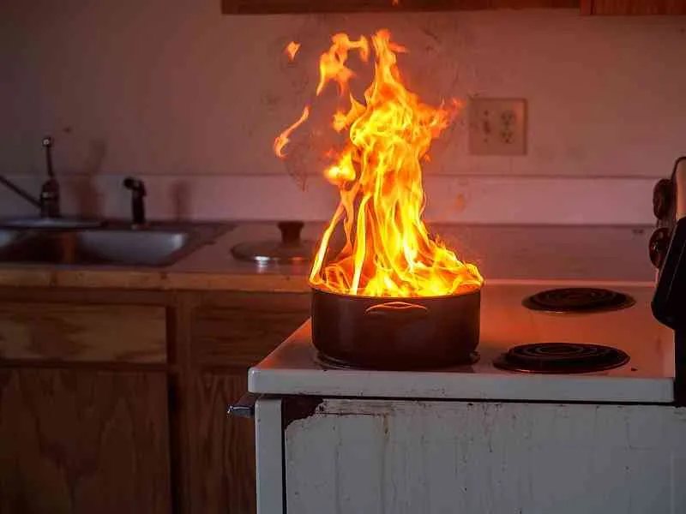
Fire
Kitchen

Slide 3

Try it yourself
Feel free to try it out

Slide 4
Problem
Recipes go trending are all over the place
Hard to find the actual recipe
Annoying to read
Hardly any user interaction
Videos only talk about the recipe

Slide 5
Solution
Photos → Insta
Videos → YouTube
Movies → Letterboxd
Books → Goodreads
Recipes → US!

Slide 6
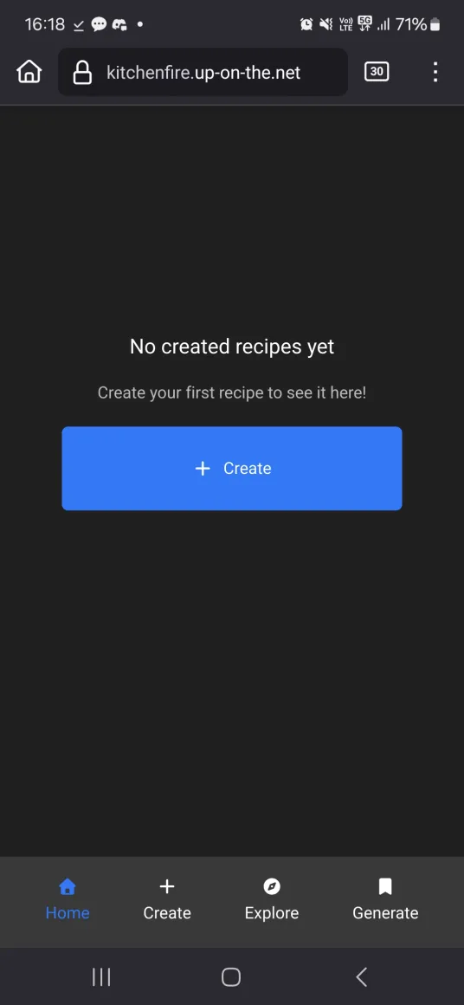
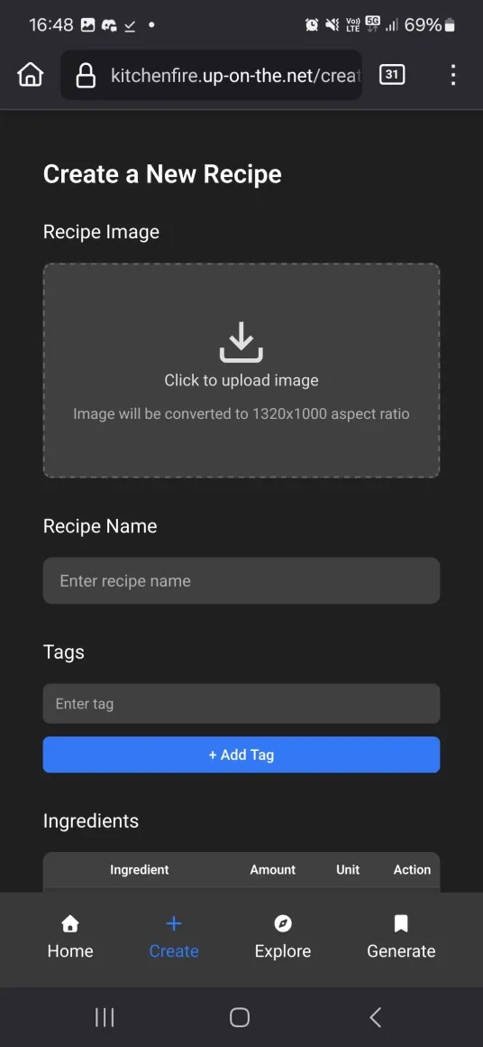
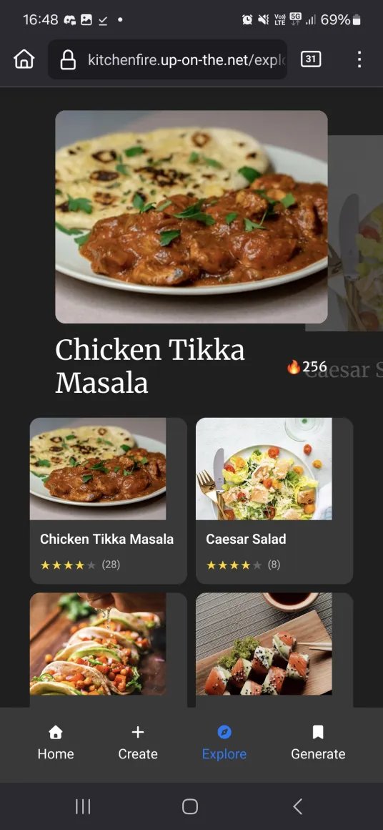
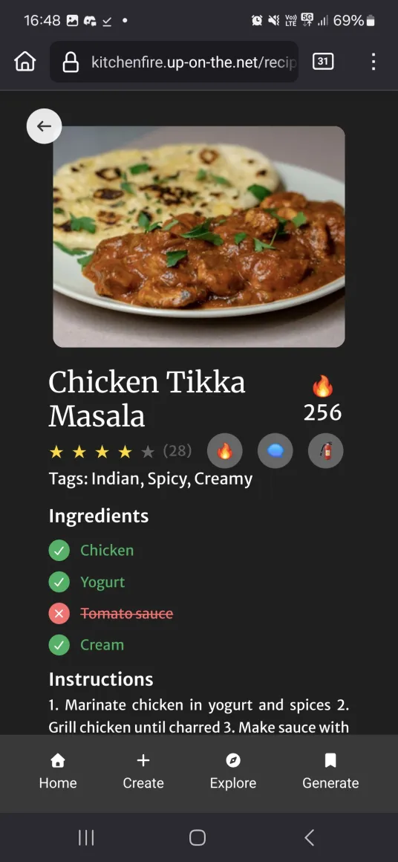
How it works

Slide 8
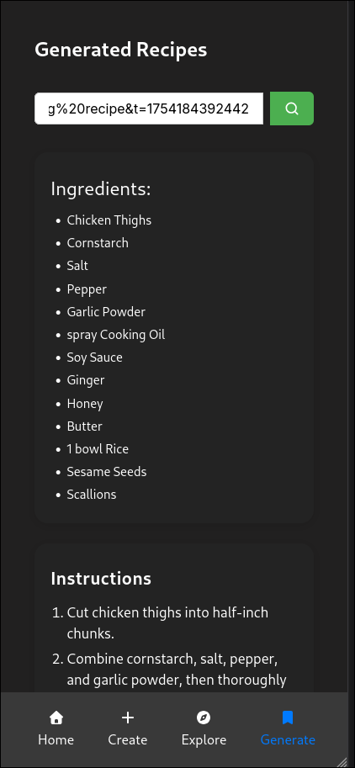
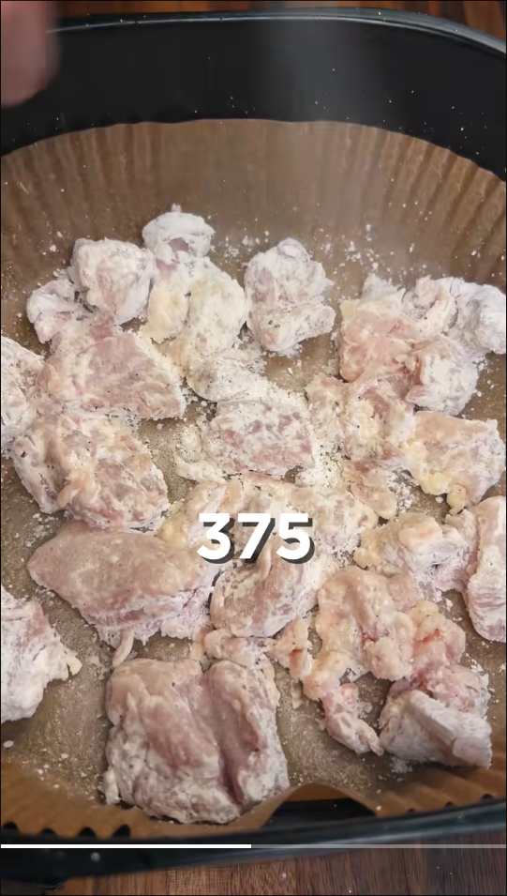
Recipe Generator
AI

Slide 9
Community Based

Slide 10
Money!
Donation based initially
Work with retailers like foodstuffs
Freemium
Premium recipes
Cooking seminars

Slide 11
Cost
Api cost for AI
Database hosting cost
Moderation

Slide 12
Future Plans

